Slide 1


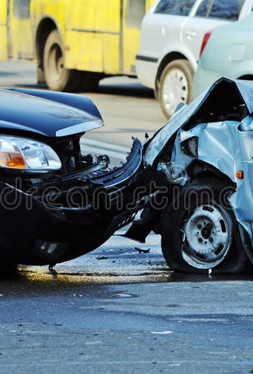
Prediction And Detection Of CAR ACCIDENTS In Video By Deep Learning
Published in: 2021 5th International Conference on Pattern Recognition and Image Analysis (IPRIA) Date Added to IEEE Xplore: 26 July 2021 Publisher: IEEE Authors : Zahra Rezaei , Hossein Ebrahimpour – komleh
GROUP – F.R.I.E.N.D.S
Suruchi Reddy kotLA 16326040
VAMSHI RAMMADUGU 16327405
Pradeep Kumar Karra 16328520
Bhavana Bollapally 16328542

Slide 2
CONTENTS
INTRODUCTION
PROPOSED METHOD
ANALYSIS OF THE METHOD
EVALUATION OF METRIC
RELATED WORK
CONCLUSION
REFERENCES

Slide 3
INTRODUCTION
Road accidents are considered as one of the leading causes of human fatality in recent decade.
❖ In order to predict accident at the stage, it is needed to learn temporal and spatial characteristics. In this paper, a primary real-time autonomous accident detection system has been proposed which is established on object detection deep learning in video prediction techniques.
❖ The events in video will be the accidents which are predicted several frames before the event.
❖ In this technique, 5000 images were labeled, and the model was classified using all the existing classes. Then, the special events were detected using object detection technique.
❖ The proposed model shows an accuracy of 92.98 and a speed of 200 images per second in video. The model can predict the event approx. 0.92 second before accident. This model can be used in inter-city cameras with immediate analysis of meta data, and it has been piloted.

Slide 4
The modern technology and challenges:
❖ Nowadays, driverless car is one of the most comprehensive technologies which has been piloted since 2009, and such cars have recently driven in crowded places and in real situation without any accidents.
❖ These cars have vision sensors which deliver images of the road and objects to a computer, and decide how to react based on the sensors. Several Challenges :
❖ The opposite cars are driven by human, and they are subject to any unpredictable behaviors of the drivers who may not observe traffic rules. Accordingly, the goal of the present paper is to predict event accidents to prevent road crashes using deep learning techniques.
❖ Labelling cost of each event in video is very high, and moreover, events which rarely occur are challenging in online video. Anomalies and events are usually context-dependent.
❖ For example, running in a restaurant can be an event while running in a park is considered a typical behaviour.
❖ These challenges make it difficult for automatic learning methods to identify video models which make abnormality in real world.

Slide 5
Dataset
Firstly , 2000 videos were downloads from Youtube
❖ 2500 images of accident scenes
❖ 2500 images of no accident scenes (Various Conditions of Accident scenes were analyzed)
Later, the videos were truncated and from each video 20 seconds before and after the accident were classified. The images from the videos were used to train the model. Totally, 1800 videos were used for the training process and another 200 were used for the test process. Each accident clip included 24 frame per second, and the images were first classified into two classes of accident images and normal images. Then, the accident images were classified into car-car accident images and car-human accident images.

Slide 6
PROPOSED METHOD
The proposed deep learning model can predict the accident 0.96 second in advance.
Tested and Useful in these cases:
❖ Accident detection in crowded areas
❖ Accident prediction in crowded and less crowded scenes
❖ Accident prediction in auto-controlled cars.
The deeper and wider convolutional architectures are used as the feature extractor at present. Detection of events like accidents is classified into the algorithm of object detection.

Slide 7
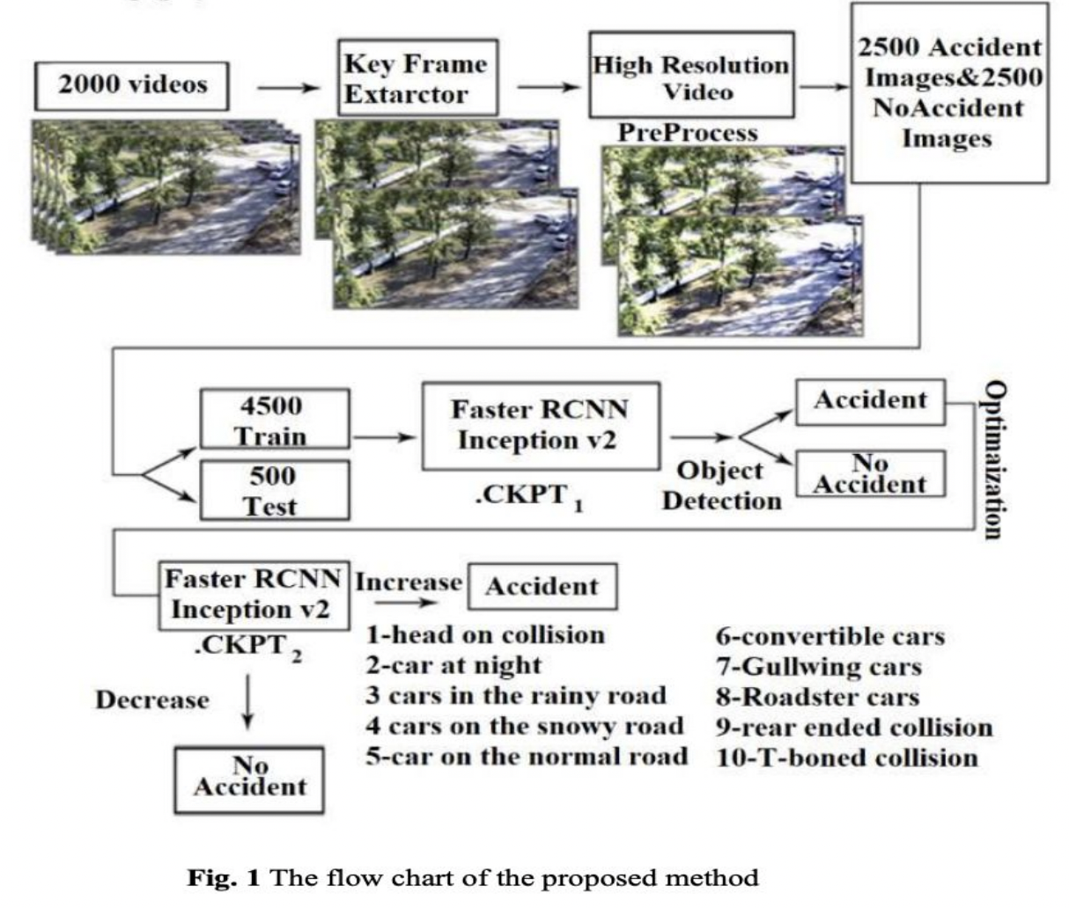
Proposed Method

Slide 8
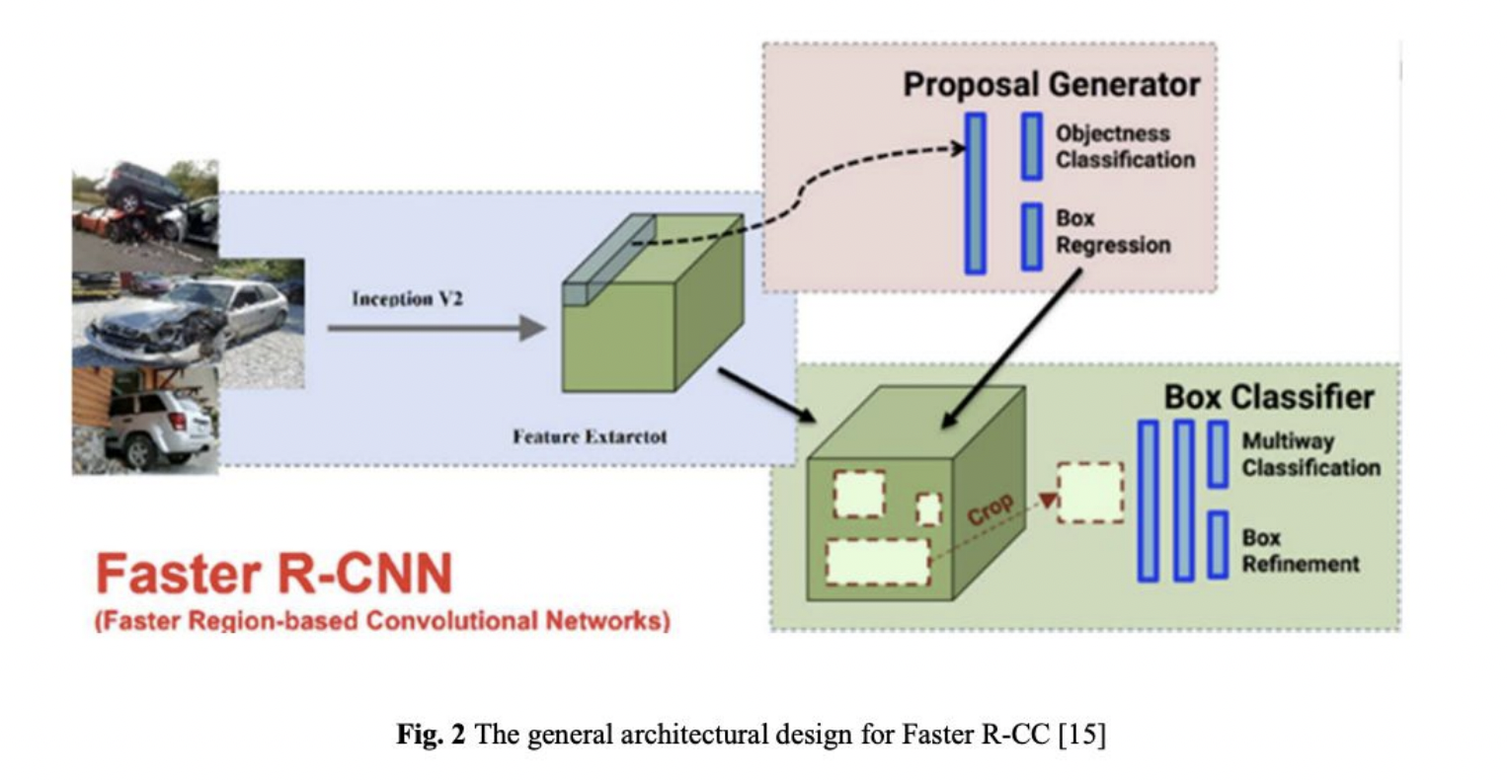
ARCHITECTURAL DESIGN FOR FASTER R - CNN

Slide 9
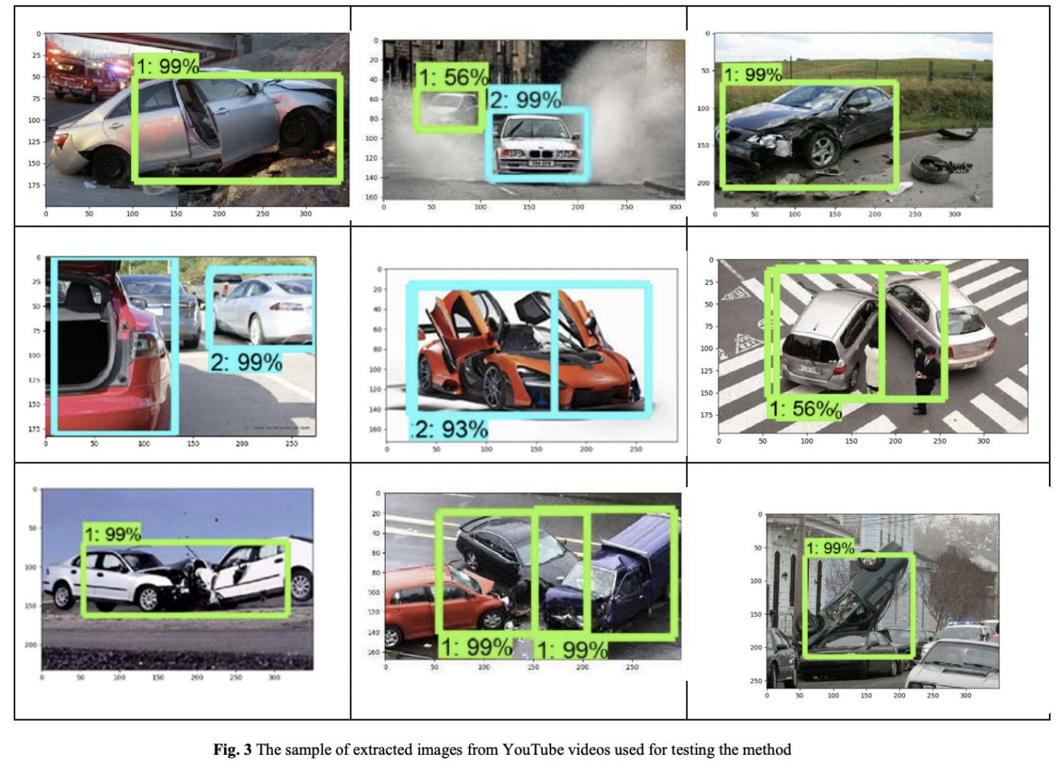
Analysis of the Method

Slide 10
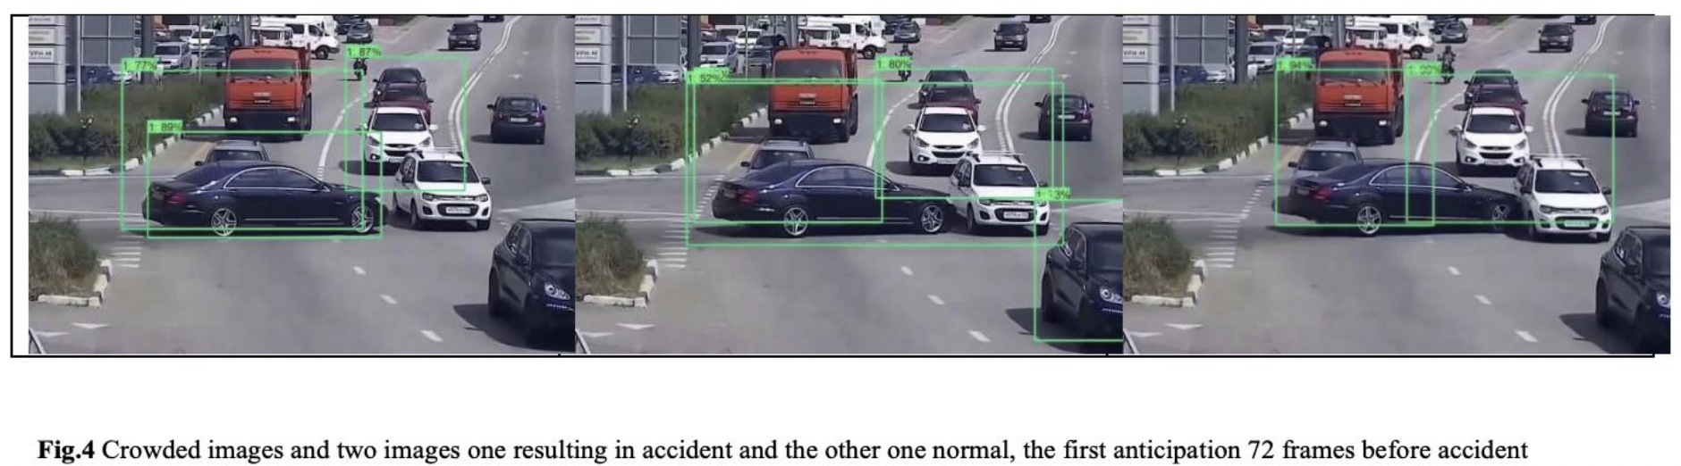
Analysis of the Method

Slide 11
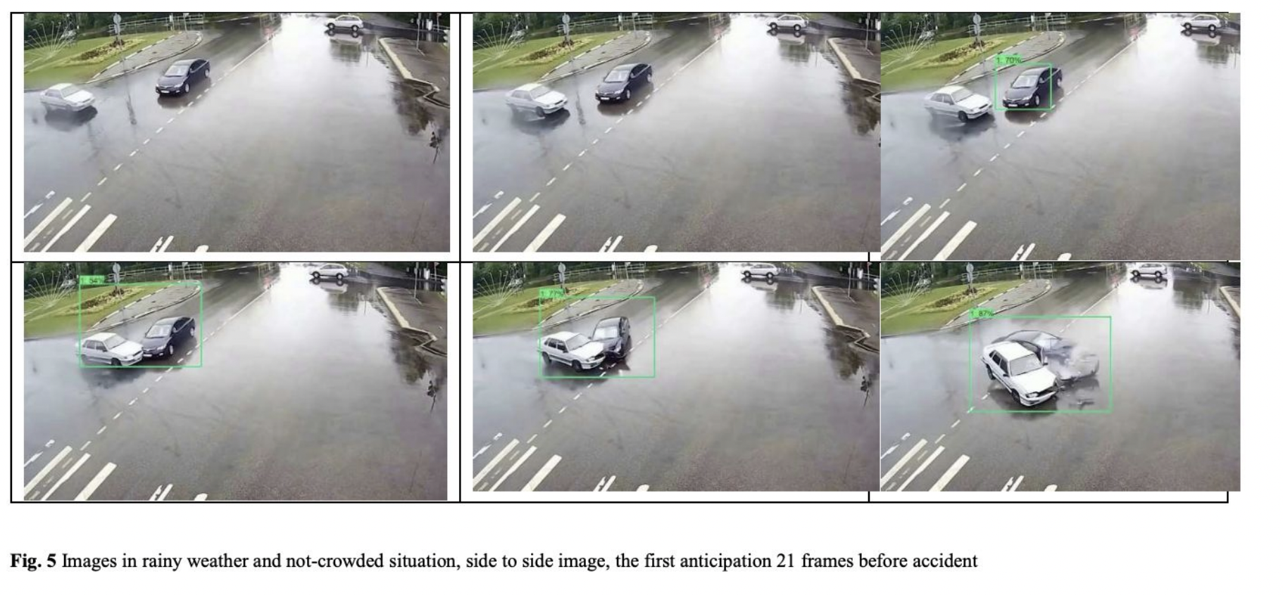
Analysis of the Method

Slide 12
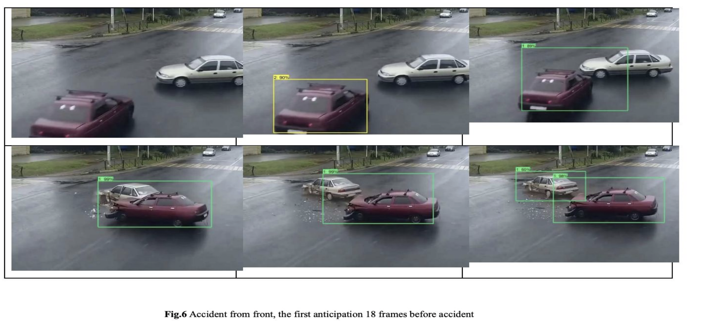
Analysis of the Method

Slide 13
Dataset cases
Data was extracted in the following cases:
❖ Rain, snow, foggy weather, day, night, an accident from front, an accident from the side, an accident with a passerby, an accident for two cars, and an accident with a road sign.
❖ The normal image of a car was contrasted with accident image of cars.
❖ Images of special vehicles like gullwing door cars, roadster car and flexible cars, due to a lack of similarity were compared with normal and accident classes.
❖ Generally, there are two classes with the above mentioned formats.

Slide 14
Extract Key Frames to Model Training
❖ Video surveys to identify key frames by humans is difficult and boring. The use of intelligent methods in basic video analysis is effective in order to extract frames. Key frame extraction is an issue in video processing.
❖ These methods is based on four general algorithms:
1. Shot Edge Analysis.
2. Computational Mean Algorithm
3. Histogram Mean Algorithm
4. Video Content Matching.
❖ After several experiments, Video Content Matching method was used as a keyframe extractor.

Slide 15
Challenges of this method
High volume data such as videos cannot be imported into classifier directly: they contain a lot of residual data, and lead in complex calculations.Therefore, video data must be shown in a way so as to be able to be processed. This is challenging due to the following reasons: ❖ Changes in act models can be diverse in a class
(for example, various road situation, the weather condition, etc.,) or classification of the event type (e.g. normal or accident).
❖ Environmental changes and noise

Slide 16
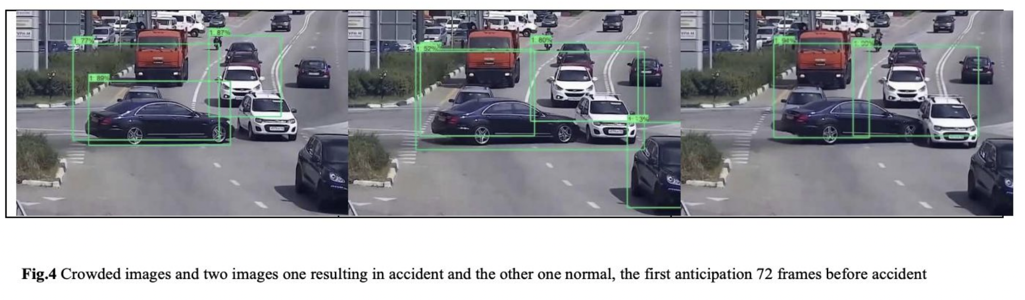
Analysis Of The Method

Slide 17
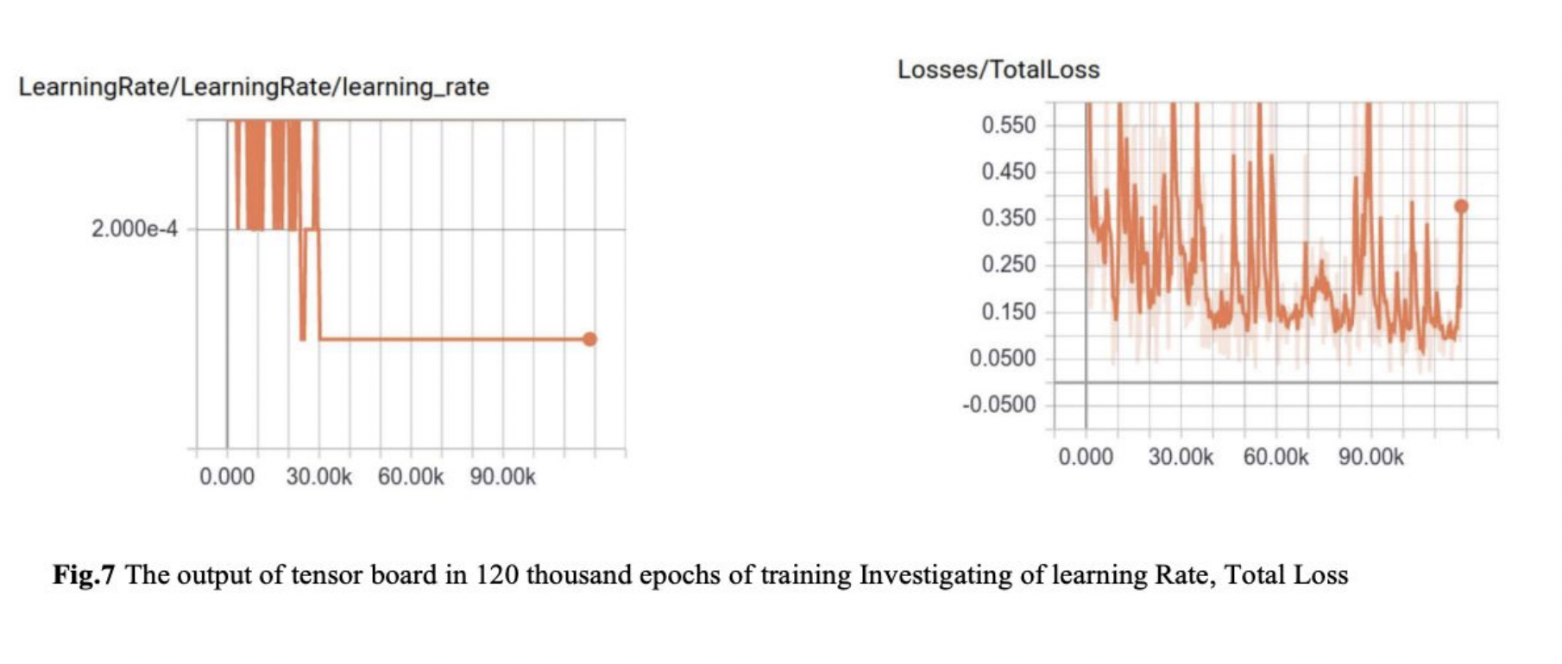
Tensor Board Output

Slide 18
Evaluation Metrics
PRECISION: Here the positive predictive value and recall sensitivity are appropriate fraction of retrieved related samples. Application of these metrics is depending on understanding of relevance.
ACCURACY: This criterion indicates how much this classification output is trustable.
F-MEASURE: This criterion is a combination of call metrics and accuracy.
KAPPA: This is often used to test the reliability of the viewer and to compare the accuracy of the system.

Slide 19
Related Work
❖ Since there are so many car accidents that happen annually, investigating car accident anticipation and detection method to be installed in automobiles can be a very useful feature and research on this is under progress.
❖ Various other research are also under progress for the detection of car accidents, they could be with the help of smartphones, with the help of vehicle infrastructure, using Internet of Things etc.

Slide 20
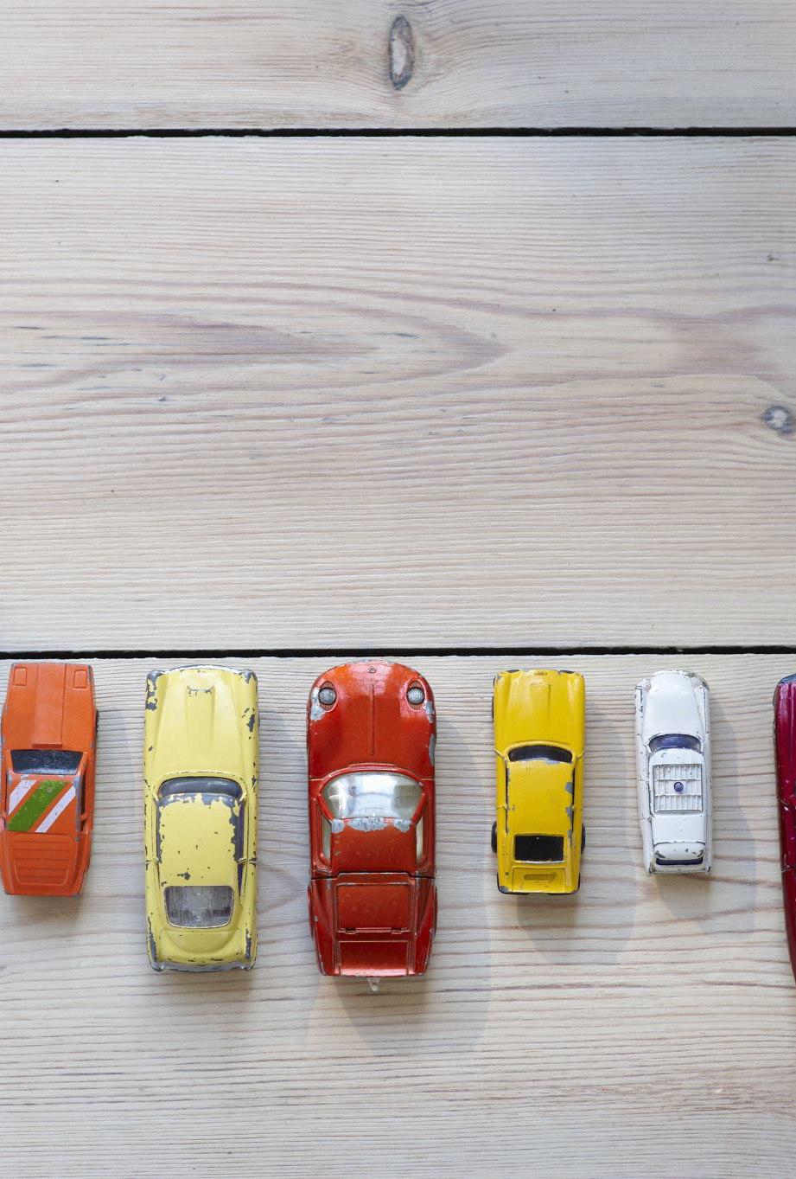
Conclusion
❖ Through this proposed model, by adding a second module, we can help reduce the false positive in overlapped images.
❖ At the end of second module, the accident threshold exceeds 78% and the system identifies image as accident image. Through this it alarms the driver and makes him aware of the danger of the accident.
❖ This proposed method shows accuracy of 92.98% in the test stage. Considering it has the anticipation of 18 frames before accident on average, it is a good result.

Slide 21
References
[1] W. h. organization, http://www.who.int/gho/road_ safety/mortality/en/, 2018.
[2] H. P. K. N.Trong, "A Comprehensive Survey on Human Activity Prediction," International Conference on Computational Science and Its Applications, no. DOI: 10.1007/978-3-319-62392- 4_30, July 2017.
[3] K.CHEN, D.ZHANG,L. YAO,B.GUO,Z.YU, "Deep Learning for Sensor-based Human Activity Recognition: Overview, Challenges and Opportunities," J. ACM, Vol. 37, No. 4, Article 111. Publication date: August 2018, no. arXiv:2001.07416v2 [cs.HC] 22 Jan 2021.
[4] R. MS, "Human activity prediction: Early recognition of ongoing activities from streaming videos," Computer Vision (ICCV), 2011 IEEE International Conference on, pp. 1036-1043, 2011.
[5] Hoai M, la Torre FD, " Max-margin early event detectors," International Journal of Computer Vision, vol. 107, no. 2, p. 191– 202, 2014.
[6] Lan T, Chen TC, Savarese S, " A hierarchical representation for future action prediction," European Conference on Computer Vision, p. 689–704, 2014.
[7] R. M, " Human activity prediction: Early recognition of ongoing activities from streaming videos," ICCV, p. 201–214, 2011.
[8] T. A. Yuen J, "A data-driven approach for event prediction," European Conference on Computer Vision, p. 707–720, 2010.
[9] Wang Z, Deisenroth MP, Amor HB, Vogt D, Schölkopf B, Peters J, "Prob- abilistic modeling of human movements for intention inference," Proceedings of robotics: Science and systems, 2012.
[10] S. A. Koppula HS, "Anticipating human activities using object affordances for reactive robotic response," IEEE transactions on pattern analysis and machine intelligence, vol. 38, no. 1, p. 14–29, 2016.
[11] Koppula HS, Jain A, Saxena A, "(2016) Anticipatory planning for human-robot teams," Experimental Robotics, p. 453–470, 2016.
[12] B. D. Mainprice J, "Human-robot collaborative manipulation planning using early prediction of human motion," Intelligent Robots and Systems (IROS),2013 IEEE/RSJ International Conference , p. 299–306 , 2013.
[13] Ma H, Lu N, Ge L, Li Q, You X, Li X, "Automatic road damage detection using high-resolution satellite images and road maps," Geoscience and remote sensing symposium (IGARSS), 2013 IEEE International, p. 3718– 3721, 2013.
[14] Ravindran V, Viswanathan L, Rangaswamy S, "A Novel Approach to Automatic Road-Accident Detection using Machine Vision Techniques", TERNATIONAL JOURNAL OF ADVANCED COMPUTER SCIENCE, 2016.
[15] Ren S, He K, Girshick R, Sun J, "Faster R-CNN: towards real-time ob- ject detection with region proposal networks," IEEE Transactions on Pattern Analysis & Machine Intelligence, vol. 6, p. 1137– 1149, 2017.
[16] Liu W, Anguelov D, Erhan D, Szegedy C, Reed S, Fu CY, Berg AC, "Ssd: Single shot multibox detector," European conference on computer vision, p. 21–37, 2016.
[17] Dai J, Li Y, He K, Sun J, "R-fcn: Object detection via regionbased fully convolutional networks," Advances in neural information processing systems, p. 379–387, 2016.
[18] Tian, Rong Pan，Yumin; Wang, Zhong“ ,Key-frame Extraction Based on Clustering ”,The 2010 IEEE International Conference on Progress in Informatics and Computing ,2010. [19] Huang L, Ye C H“ ,The research and implementation of keyframe extracion methods in contentbased teaching video retrieval ”,Consumer Electronics, Communications and Networks (CECNet) 2012 2nd International Conference on. IEEE ,pp .2179- 2182 ,2012 . [20] Uma, BH Shekar ， KP“ ,Kirsch Directional Derivatives Based Shot Boundary Detection: An Efficient and Accurate Method ”,Procedia Computer Science ,VOL 58 ,pp. 565-571 , 2015.

